Slide 1





JavaScript Fundamentals
Course Overview
Fundamentals
JavaScript Fundamentals
SoftUni Team
Technical Trainers
Software University
http://softuni.bg

Slide 2


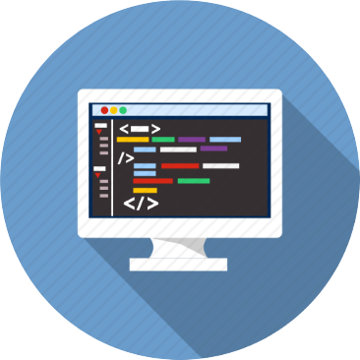
Table of Contents
Course Objectives
Course Program
Trainers Team
Course Schedule
Exams and Evaluation
Learning Resources

Slide 3
Have a Question?
sli.do #JSCORE

Slide 4







SoftUni Diamond Partners

Slide 5

JS Core Module @ SoftUni
JavaScript Core
Intensive 4 Months JavaScript Training

Slide 6
JS Core Module Goals
4 months intensive JavaScript development training
4 times weekly, lots of live coding, homework and projects
Part I – JS Fundamentals
JS programming, functions, arrays, strings, objects, JSON, …
Part II – JS Advanced
jQuery, DOM, object composition, classes, modules, unit testing
Part III – JS Apps
REST, AJAX, promises, templating, routing, building SPA

Slide 7
JS Core Module at SoftUni – Timeline
22-May-2017
19-Jun-2017
24-Jul-2017
20-Aug-2016
4-Sep-2017
JavaScript
Fundamentals
Lessons + exercises + workshop + exam
4 weeks * 4 times / week
9 credits
Start: 22-May-2017
Final exam: 18-Jun-2017
JavaScript Advanced
Lessons + exercises + exam
5 weeks * 4 times / week
9 credits
Start: 19-Jun-2017
Final exam: 23-Jul-2017
JavaScript Applications
Lessons + exercises + exam
4 weeks * 4 times / week
9 credits
Start: 24-Jul-2017
Final exam: 20-Aug-2017
Summer Break
2 weeks
Re-Take Exams
3 exams
Dates TBA

Slide 8
Professions @ SoftUni
Java
Fund.
Java
DB
Java
Web
Programming Basics
C#
Fund.
C#
DB
C#
Web
Tech Module
JS Core Module
JS
Web
Web
Basics
PHP
Fund.
PHP
Web
Web
Basics
https://softuni.bg/curriculum
https://softuni.bg/trainings/courses

Slide 9

JavaScript Fundamentals
Fundamentals
Course Objectives & Program

Slide 10

Course Objectives
The JavaScript Fundamentals course provides
Basic coding skills for the JS language
Establishes fundamentals for further JS trainings
Content: JS syntax, data, arrays, objects, functions
What is NOT covered?
Object-oriented programming (OOP) in JS
DOM manipulation, JS libraries and frameworks (AJAX, jQuery, AngularJS, ReactJS)

Slide 11

Course Topics
JS intro, JS syntax, data types, expressions
Operators, conditional statements, loops
Functions and arrow functions (lambda)
Arrays and multi-dimensional arrays
Strings and regular expressions
Objects, JSON, associative arrays
Sets and maps, destructuring
Canvas 2D + DOM and events

Slide 12
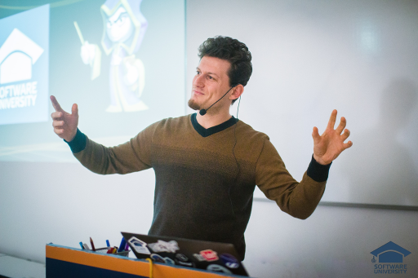
The Trainers Team

Slide 13
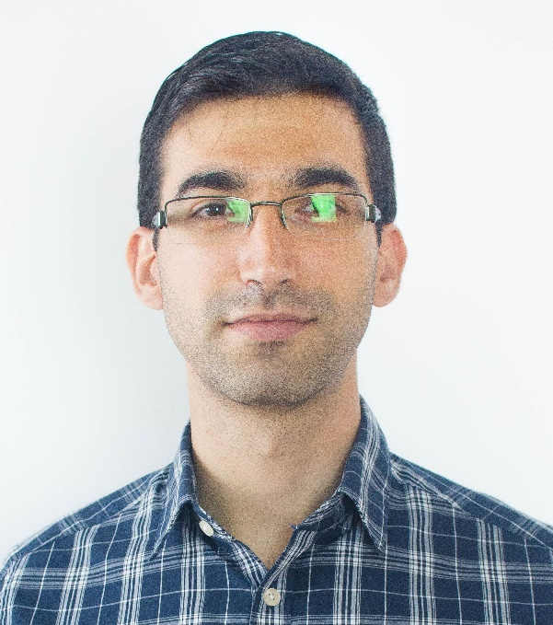
Trainers Team
Viktor Kostadinov
Technical Trainer @ Software University
Programmed as a hobby since high school
Developed a resource-sharing website during his university years
Top performing student from the Software University
Interests include astronomy and game development

Slide 14
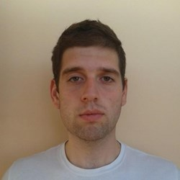
Trainers Team (2)
Valentin Kolev
Technical Trainer @ Software University
Top performing student from the Software University
Experience in developing mobile apps

Slide 15
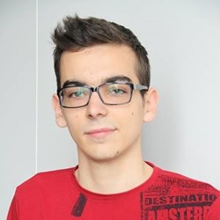
Trainers Team (3)
Kiril Kirilov
Assistant Trainer @ Software University
Involved with programming since 11th grade
Mostly interested in web development with ASP.NET
Currently studying Math & Informatics at the University of Sofia

Slide 16
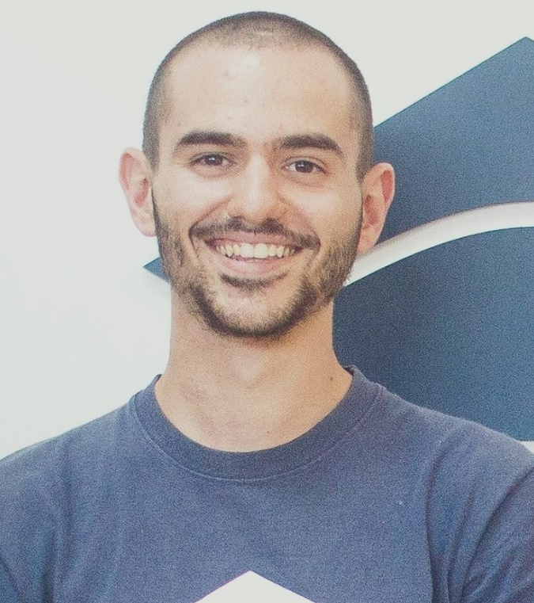
Trainers Team (4)
Bozhidar Gevechanov
Technical Trainer @ Software University
Top performing student from the Software University
Experience in developing mobile games with Unity3D

Slide 17
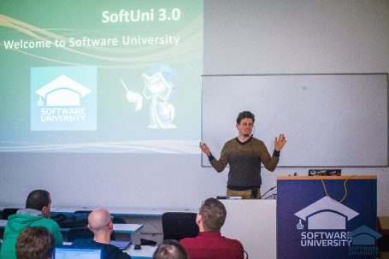


JavaScript Fundamentals
Course Details and Schedule

Slide 18
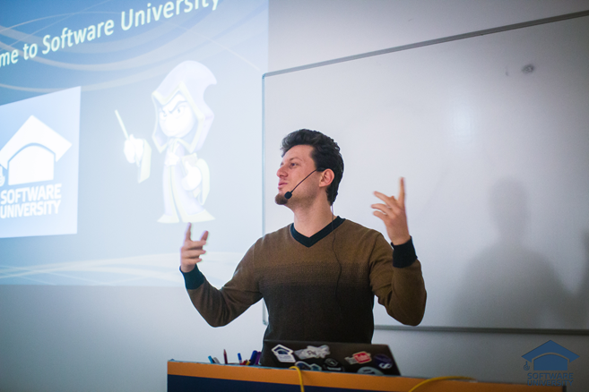
Training Duration and Schedule
Lessons: ~ 20 hours (onsite + YouTube videos)
Practical exercises (in class): ~ 40 hours
Homework: ~ 0-50 hours
Time frame
22-May-2017 – 18-Jun-2017

Slide 19


Why English?
Why the slides are in English?
English is the native language of the software engineers
Specific terminology should be in English
Translations are inaccurate and funny
Just learn English!
No excuses

Slide 20
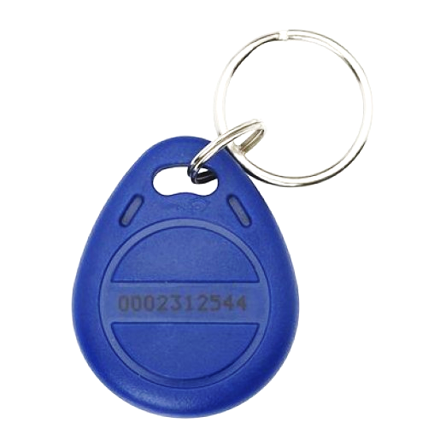
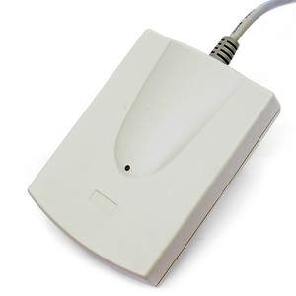
Your RFID Chip
Students can either
Take RFID chip from SoftUni
Or use their own chip / card (125 KHz)
Register your chip number in your SoftUni profile: https://softuni.bg/users/profile/show
Check-in at the reception every time when you come in SoftUni
See your last visits in your profile: https://softuni.bg/users/profile/show

Slide 21

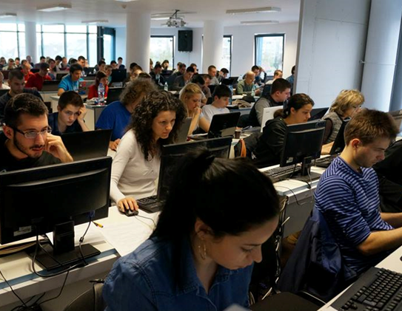
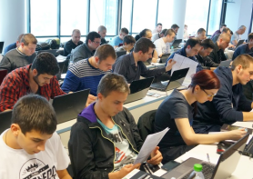
JavaScript Fundamentals
Evaluation Criteria

Slide 22
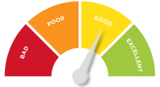

Scoring System for the Course
Mandatory:
Final exam – 85%
Exercises & homework – 15%
Bonuses:
Presence in class – 5% bonus
Forum activity – bonus up to 5%

Slide 23


Homework Assignments & Exercises
Your homework is mainly work in class!
Lesson days → slides + live demos + exercises
Exercise days → only exercises
How to submit your homework?
Submitted in the judge system
Homework assignments are due in 7 days
Due for both lesson days and exercise days

Slide 24

Practical Teamwork Project
Optional course with lessons and exercises
Gain additional skills for working in a team
Develop a practical project
Demonstrate your work live at SoftUni
The course awards 3 extra credits
View course details:
https://softuni.bg/trainings/1686/
practical-teamwork-javascript-may-2017

Slide 25
Teamwork Details
Work on three assignments
Students who don't participate will not be eligible for the final project
Work in a team of 5 persons
Teammates are randomly assigned
Develop a practical project
Public defense after your exam session
Participants will be favored in the Career Center

Slide 26
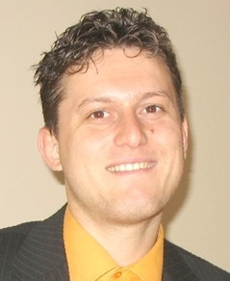
Guest Lecturers
Svetlin Nakov, PhD
Training & Inspiration Manager @ Software University (SoftUni)
20+ years software development experience
10+ years experience as trainer
Author of 7 programming books
Speaker at hundreds of events
Winner in International programming contests and Olympiads
Web site & blog: www.nakov.com

Slide 27
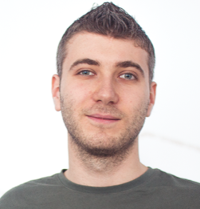
Guest Lecturers (2)
Ivan Yonkov
Training Director @ SoftUni
5 years of programming experience mainly with Java and PHP
Solid experience as a QA engineer
Top performing student from the Software University (2014)

Slide 28










Resources
What We Need Additionally?

Slide 29



Course Web Site, Forum and FB Group
Official web site:
Official discussion forum:
Official Facebook group:
softuni.bg/courses/javascript-fundamentals
softuni.bg/forum/categories/12
fb.com/groups/292674664491806/

Slide 30

The Programming Basics Slides and Videos
All lecture slides, videos, homework assignments, projects and other resources are open content, available for free
Visit the course web site to access the course resources

Slide 31



Recommended Software
Software needed for this course:
Noje.js – https://nodejs.org
WebStorm – https://jetbrains.com/webstorm/
Optionally:
Visual Studio Code – https://code.visualstudio.com

Slide 32
JavaScript Fundamentals – Course Overview
https://softuni.bg/courses/

Slide 33
License
This course (slides, examples, demos, videos, homework, etc.) is licensed under the "Creative Commons Attribution-NonCommercial-ShareAlike 4.0 International" license

Slide 34





Free Trainings @ Software University
Software University Foundation – softuni.org
Software University – High-Quality Education, Profession and Job for Software Developers
softuni.bg
Software University @ Facebook
facebook.com/SoftwareUniversity
Software University Forums
forum.softuni.bg

